Slide 1
Mini Project-2B: FPGA Design Project (Semester VI)
Electronics and Telecommunication Engineering
Name of Supervisor :
IMAGE ENHANCEMENT USING
FPGA AND VERILOG

Slide 2

Contents to be covered
Abstract
Problem Statement
Proposed Solution
Literature Survey
Complete Block Diagram of Proposed System
State Diagram of The proposed system
Working
Simulation Results
Advantages, Disadvantages & Applications
Conclusion

Slide 3
Abstract
In order to implement the image processing algorithms and to process the amount of data captured from sources such as medical instruments, intelligent high speed real-time systems, etc. has become imperative.
In this project, an efficient FPGA-based design and implementation of image processing algorithm will be presented using hardware description language.
The FPGA provides the necessary hardware for image processing algorithms with flexibility to support image processing by using point operations.
Verilog Coding is done in Xilinx ISE Design Suite 14.7

Slide 4
Problem Statement
Image Enhancement is a wide area with its applications in different domains. Image Enhancement is a computational intensive task in which processing involves applying a specific function repetitively.
Also to Improve the human interpretation and enhance the pictorial visual information.
One solution to carry out these computational intensive tasks is to use a general-purpose microprocessor or Digital Signal processors.

Slide 5
Proposed Solution
FPGAs being used as a platform for accelerating computationally intensive tasks.
Aim is to explain some basic image enhancement strategies employing a hardware description language, Verilog.
In this project we implemented four basic operations of Image Enhancement i.e. threshold, contrast, brightness, invert to manipulate the RGB values of every pixel of the image to improve the human interpretation of image.

Slide 6
Literature Survey
Sr. No. | Title of Technical paper | Name of Author | Year of publication | Name of Journal | Methodology | Results/ conclusions | Drawbacks/ limitations
1. | FPGA Implementation of Image Enhancement | Mandeep Singh Narula, Nishant Singla | May- 2018 | IRJET |  | The simulation results obtained
2. | Implementation of Image Processing Algorithms on FPGA hardware | Anthony Edward Nelson | May- 2000 | Graduate School of Vanderbilt University
3. | FPGA Implémentation of Image Enhancement Techniques | Atul Srivastava | June- 2010 | The International Society for Optical Engineering

Slide 7
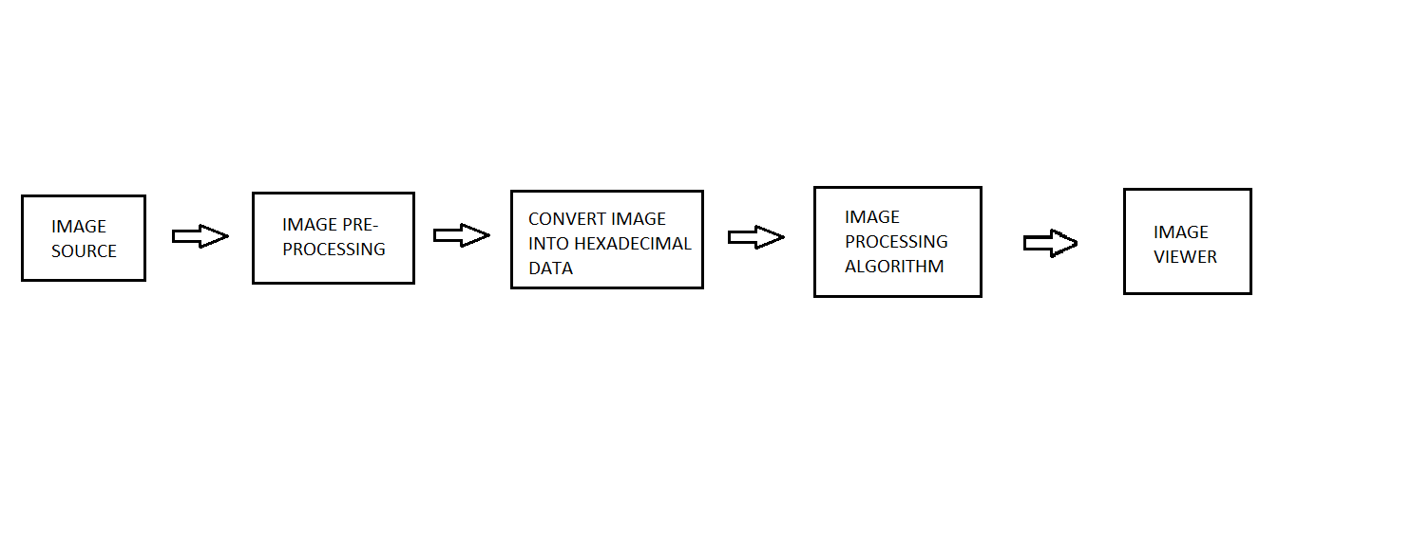
Block Diagram of the Proposed System

Slide 8
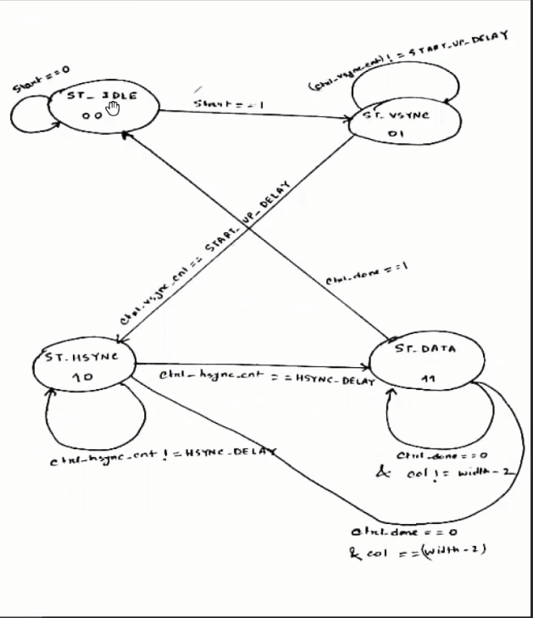
State Diagram of the Proposed System

Slide 9
Working
STEP 1 : Take an image file (jpeg/png/jpg/bmp)
STEP 2 : Convert it in hexadecimal file using MATLAB
STEP 3 : Use this hexadecimal file as input of Xilinx
STEP 4 : Select the operation which you want to perform on input image
(Brightness, Invert, Black & White, Threshold)
STEP 5 : Simulate and finally get the output

Slide 10
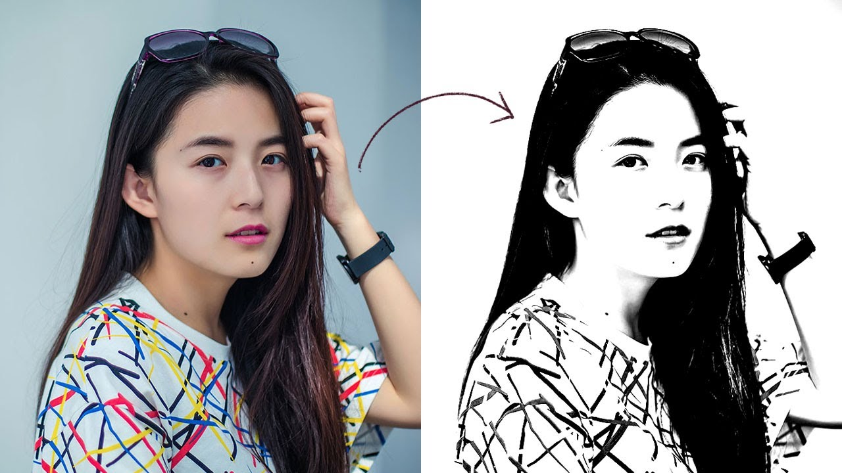
Working
Black & White image
The image is simply
converted here from RGB to
Black and white
The image has only 2 colours
here either black or white

Slide 11
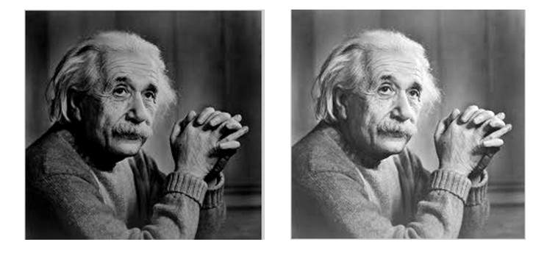
Working
Brightness
This module changes the brightness of the picture by adding or subtracting a fixed value to the pixel value.

Slide 12
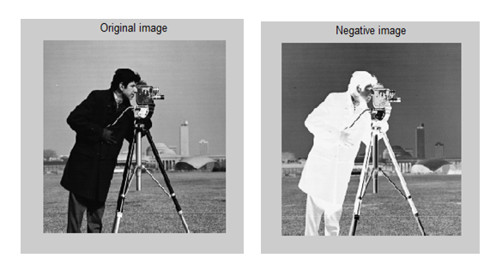
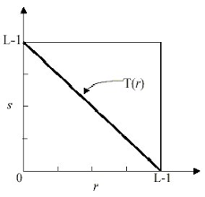
Working
Inverting: This module inverts an image by inverting the bits of the grayscale pixel value of an image.
Invert image
Equation is s = L-1-r

Slide 13
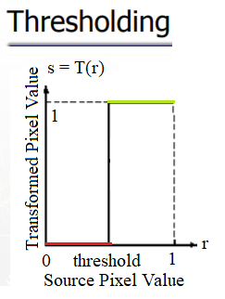
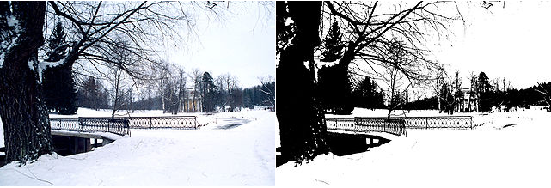
Working
Threshold
This module is used to perform the threshold operation i.e. set the pixel above a threshold value to 255 and below it to 0.

Slide 14


Simulation Results
Original Image
Brightness Operation

Slide 15
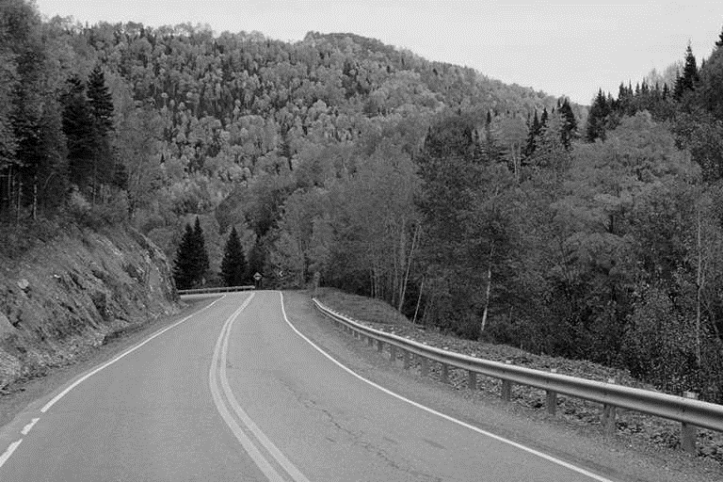
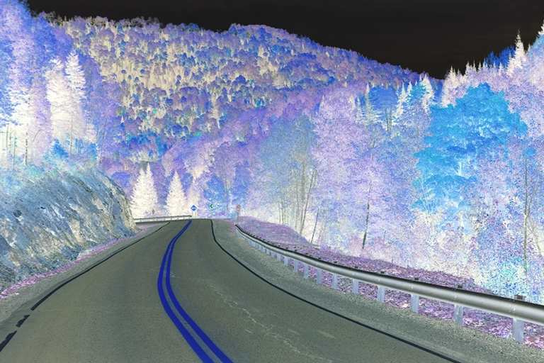
Simulation Results
Black & White Operation
Invert Operation

Slide 16
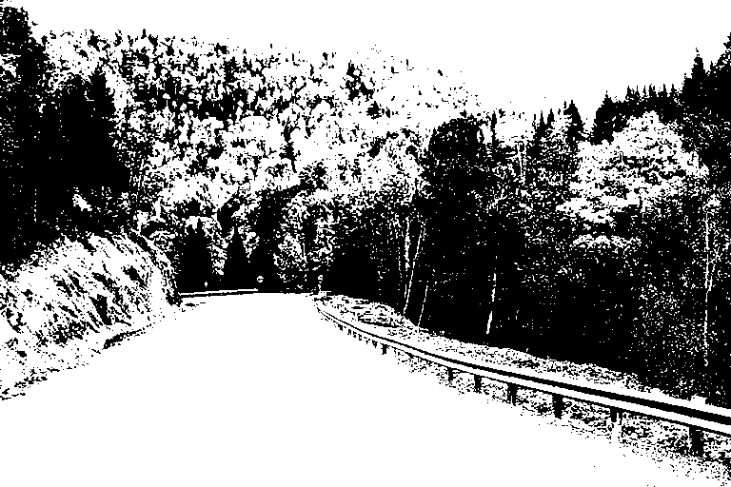
Simulation Results
Thresholding Operation

Slide 17
Advantages
FPGA is able to perform high-speed image/video processing than CPU implementation.
Some important advantages of FPGA are Better performance than DSP’s , Less Time to Market, Low long-term Cost, More Reliability, Long-term Maintenance .
The FPGA-based acceleration of imaging algorithms has become mainstream as it can compute intensive tasks.
Pixels in the image can be manipulated to any desired density and contrast

Slide 18
Disadvantages
The development of FPGA image processing algorithms can at times be quite tedious
One of the drawbacks of the techniques presented is the large size of the algorithms
On an FPGA, it is necessary to design not only the algorithm but also the computational architecture, which leads to an explosion in the design space complexity.

Slide 19
Applications
Medical Application
Digital Video Technology and Image Processing
Industrial Application
Digital Signal Processing
Communications and Networking-Satellite based Internet data tracking system
Rapid Systems Prototyping-Automotive safety system incorporating sensor fusion
Content processing solutions- Compression/decompression
Custom Vector Engines
3D modelling, Ray Tracing

Slide 20
Conclusion
The simulation results obtained after applying the operations described using Verilog HDL to an input image
The image enhancement technique such as brightness is important especially in medical images.
A large part of the improvement possible in this design lies in the algorithms themselves.
Field programmable Gate Arrays (FPGAs) prove to be a better solution for rapid prototyping.
FPGAs are reprogrammable, have large number of logic cells suitable for implementing image enhancement applications.

